Slide 1
Intelligent Lead Discovery & Context-Based Outreach Engine

Slide 2
Contents
Objective
Workflow Diagram
Working Prototype
Key Performance Observations
Tools Used & Rationale
Limitations & Safeguards

Slide 3
OBJECTIVE
Lead Acquisition – Collect qualified prospect data from websites and event lists.
Data Enrichment & AI Research – Automatically enrich and analyze company information to understand context and pain points.
Personalized Outreach Generation – Create highly tailored email content for each prospect at scale.
Workflow Automation – Automate the full pipeline from scraping to email delivery with minimal manual effort.
Performance Optimization – Improve deliverability, open rates, reply rates, and ensure compliance & quality control.

Slide 4
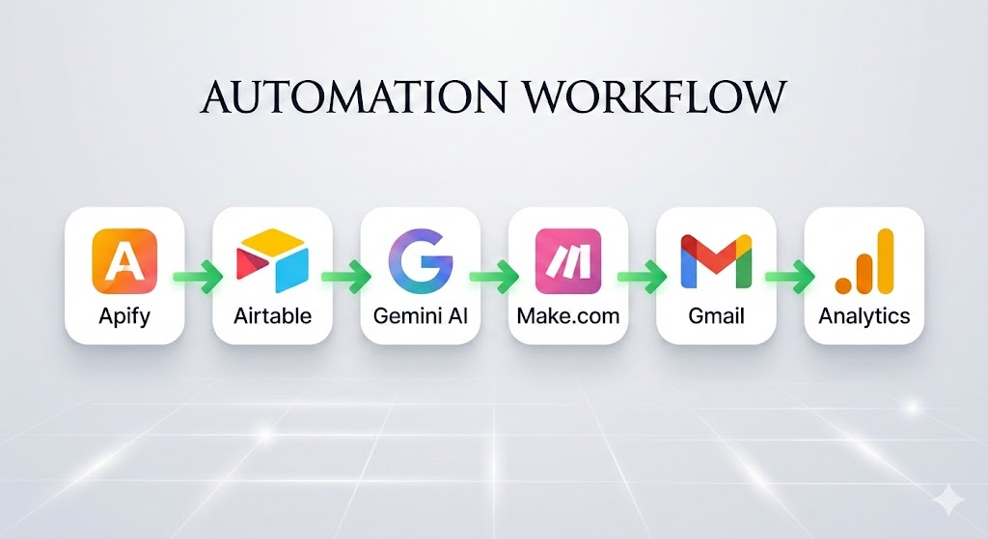

Slide 5
WORKFLOW DIAGRAM

Slide 6
WORKING PROTOTYPE
Data Extraction (Apify)
Data Storage & Management (Airtable)
AI Research & Personalization (Gemini AI)
Workflow Automation (Make.com)
Email Delivery & Performance Tracking (Gmail + Analytics)
Apify → Airtable → Gemini AI → Make.com → Gmail → Analytics

Slide 7
KEY PERFORMANCE OBSERVATIONS
92% Email Deliverability (after validation & throttling)
Higher Open Rates due to AI-driven personalization
Improved Reply Rates with contextual company references
Lower Bounce Rate through email verification
Reduced Manual Effort via full automation workflow

Slide 8





KEY PERFORMANCE OBSERVATIONS
Tool | Primary Role | Why Selected
 | Web Scraping | Free-tier actors, no-code setup, scalable data extraction
 | Database Management | Structured storage, API-ready, real-time tracking
 | AI Research & Personalization | Free API access, strong contextual analysis, dynamic email generation
 | Workflow Automation | Visual builder, multi-tool integration, advanced routing logic
 | Email Delivery | Free SMTP access, easy integration, reliable for testing

Slide 9
LIMITATIONS AND RISKS
Category | Key Risks | Safeguards
Data Quality Issues | Incomplete/outdated contacts, scraping inconsistencies | Email validation, structured scraping rules, deduplication logic
AI Hallucination Risks | Incorrect assumptions, fabricated insights | Prompt constraints, real-data referencing, output validation checks
Email Compliance Concerns | GDPR/CAN-SPAM risks, unsolicited outreach | Opt-out option, targeted outreach, compliance alignment
Rate Limiting & Sender Reputation | Gmail limits, spam flagging, domain impact | Daily caps, throttling, SPF/DKIM setup, sender warm-up
Edge Case Handling | Missing emails, duplicates, minimal website data | Fallback templates, manual review, error logging

